Slide 1
SOA, DDD, CQRS, CAP/BASE, and NServiceBus
- Harry Chou

Slide 2
System
The Whole Thing
Our Code → Things that we develop to fulfill the requirements
SuD
Their Code → that our code depends on
Things that, if change, will trigger changes on our end
Example: request/response partners, publishers (that our code subscribe to)
Their Code → that depends on our code
Things that, if we make changes on our end, may be impacted
Example: User/admin docs, monitoring counters, request/response partners, subscribers (that we publish messages to)

Slide 3
Availability
Time Lost
Availability is the amount of time a device is actually operating as the percentage of total time it should be operating.
In high availability applications, availability may be reported as minutes or hours of downtime per year.
If users or other systems want to do X with your system, but can’t, your system is not available …
It doesn’t matter why it is not available …

Slide 4
Reliability
Number of Failures
Reliability means features that help avoid and detect faults.
A reliable system does not silently continue and deliver results that include uncorrected corrupted data, instead it detects and corrects the corruption when possible.
If there is an error in the system (from any related components), how well the system would respond to the error …
Hard to measure, how do we know the unforeseen errors …

Slide 5
Loose Coupling (Design-Time)
Design/Development-Time Coupling
One party’s change won’t request changes to the other party
We have good understanding of this (Not that we have perfected it)
Data Coupling ← Contract/Schema
Platform Coupling ← Standard
Network Coupling ← End-Point
Behavior Coupling ← Policies

Slide 6
Loose Coupling (Run-Time)
Run-Time Coupling
One party’s error won’t cause the other party to error
Related to Run-Time aspects of services:
Availability, reliability, robustness, scalability
Run-Time Autonomous Services
a service whose ability to function is not controlled or inhibited by other services
self-governing, self-controlling, independent, self-contained, and free from external control and constraint

Slide 7
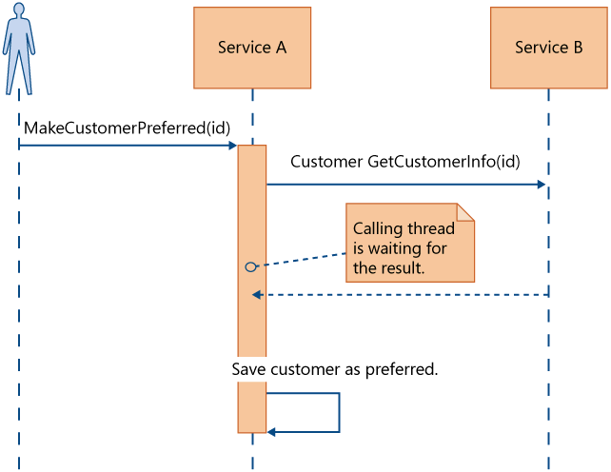
Run-Time Autonomy – The Problem
Service A is not Autonomous
Rely on Service B to be available
Rely on Service B to be performant
Rely on Service B to be correct

Slide 8
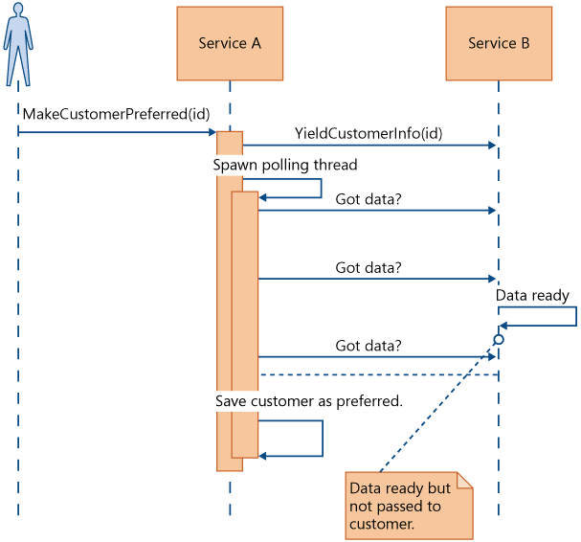
Run-Time Autonomy – Solution 1

Slide 9
Run-Time Autonomy – Solution 2

Slide 10
UI Autonomy (Draft)
Design-Time Autonomy
One Service’s change should not cause change to another Service
Sounds Good
What about UI Layer?
The Integrated UI layer still need to be changed
Using UI Composition to achieve UI Autonomy

Slide 11
Transaction

Slide 12
Domain Driven Design
Strategic Design
How to grow a system with large model
Bigger Picture: Team or Cross-Team
Don’t try to model the whole business (classical mistake of EDM)
Tension:
Modularity without sacrificing integration
Bounded Context

Slide 13
SOA Conceptual Model
Policy
adheres to
governed by
End Point
binds to
exposes
Consumer
Service
serves
Contracts
understands
implements
describes
Messages
sends/receives
sends/receives

Slide 14
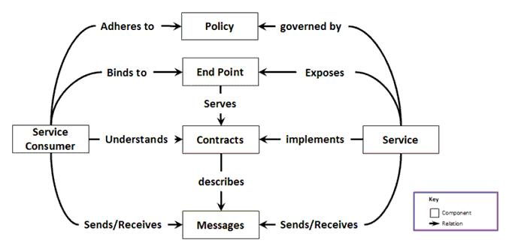
SOA Defined
Service Oriented Architecture as an architectural style for building systems based on interacting coarse grained autonomous components called services. Each service expose processes and behavior through contracts, which are composed of messages at discoverable addresses called endpoints. Services’ behavior is governed by policies which are set externally to the service itself.

Slide 15
End Point

Slide 16
NServiceBus – Get Started
Setting up
VS 2010
Make sure Nuget Package Manager is installed
Dowload NServiceBusXXX.zip (unlock)
Execute RunMeFirst.bat to setup
MSMQ, DTC, RavenDB, … etc

Slide 17
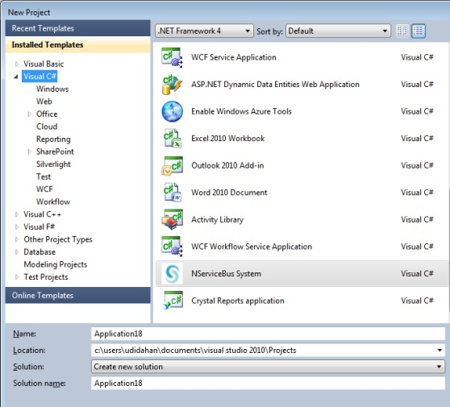
NServiceBus – File/New

Slide 18
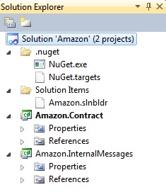
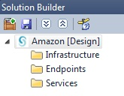
NServiceBus – File/New
Solution Explorer
.nuget folder
Solution Items
XXX.Contract
All events
XXX.InternalMessages
All commands
Solution Builder
Infrastructure
Cross cutting concerns such as authentication, and auditing
Endpoints
Web or NServiceBus Host endpoints
Services
Logical components to send/process, publish/subscribe to messages

Slide 19
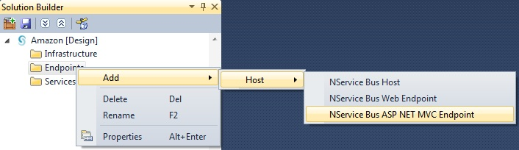
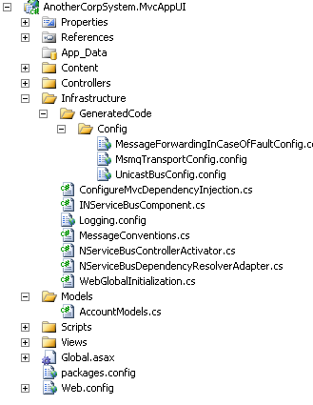
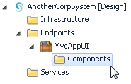
NServiceBus – New Web UI
Do this →
The result:
MVC App in source explorer
In Solution Builder

Slide 20
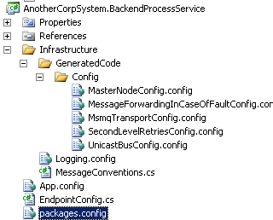
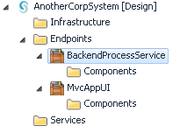
NServiceBus – Backend Service
Do this
Endpoint > Add > Host > NService Bus Host
The result:
MVC App in source explorer
In Solution Builder

Slide 21
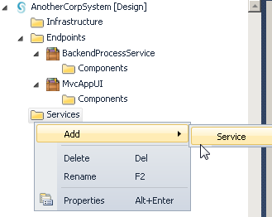
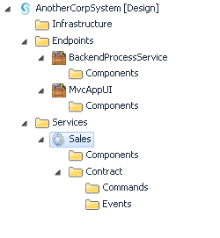
NServiceBus – Create Service
Add a new service
The result
Not code change
Only in Solution Builder

Slide 22
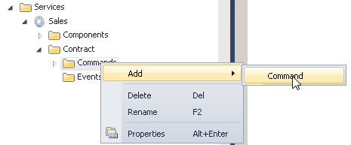

NServiceBus – Add Command-Type Contract
Do this:
Code change
namespace AnotherCorpSystem.InternalMessages.Sales
{
public class SubmitOrder
{
}
}

Slide 23
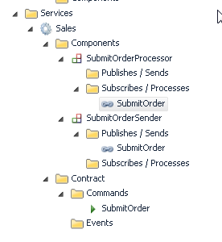
NServiceBus – Add Command-Type Contract
Solution Builder
Two new components
XXXProcessor
XXXSender
Contract
Commands

Slide 24
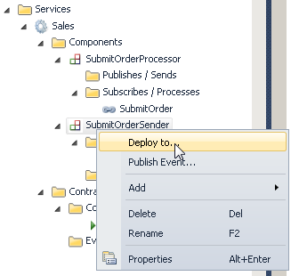
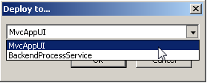
NServiceBus – Deploy to EndPoint
Goal
WebUI (part of Sales service) will send the command
Backend (part of Sales service) will process the command

Slide 25
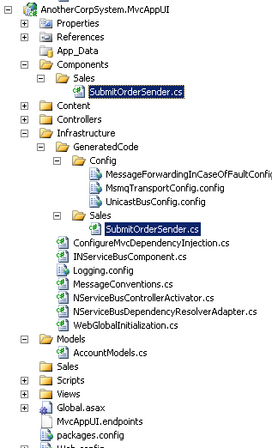
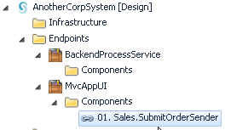
NServiceBus – Deploy to Endpoint
Endpoint Code
SubmitOrderSender class
Modify the component one
The infrastructure one is generated by tool

Slide 26
NServiceBus – Durable Messaging
What if one component is unavailable?
In Send/Process scenario
The Sender should be available (if not, no message will be generated ;=))
If the Processor is unavailable
NServiceBus will queue the message in MSMQ
Once the processor is back online, the messages will be processed
What about consistencies? (make sure your processing does not depend on the sequence of the messages)

Slide 27
NServiceBus – Fault Tolerance
What if one component encounters error?
In Send/Process scenario
If the Processor encounters error
For some scenarios, immediate retry is the correct approach
Ex. DB Deadlock
NServiceBus by default will retry 5 times
For some scenarios, second level retry
For some scenarios, What about consistencies? (make sure your processing does not depend on the sequence of the messages)

Slide 28
CAP Theorem – BASE vs. ACID

Slide 29
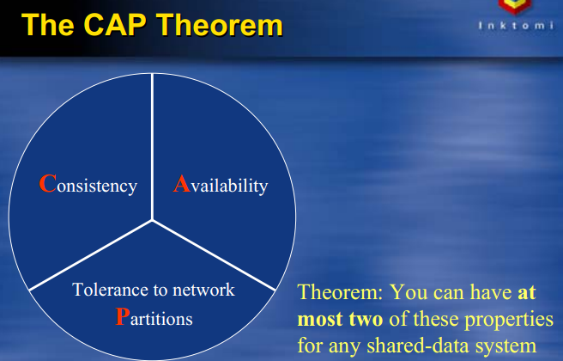
CAP Theorem
A shared-data system can have at most two of the three following Properties:
Consistency,
Availability
Tolerance to network Partitions.

Slide 30
Consistency
Traditional Definition in database (ACID):
Any transaction will bring the database from one valid state to another
Any data written to the database must be valid according to all defined rules and checks
In CAP and BASE
Equivalent of having only one set of data
For all nodes/parts of the system, there is no difference between the same data

Slide 31
Availability
Traditional Sense:
No Downtime
In CAP/BASE Definition:
(Shared Data Perspective) Client can update the set of shared data
Or
Every request received by a non-failing node in the system must result in a response
Any algorithm used by the service must eventually terminate
Even when severe network failures occur, every request must terminate
No Availability
Network Timeout == NOT Available
500 Error or Exception == NOT Available

Slide 32
Tolerance to Partition
Traditional Sense:
No Downtime
In CAP/BASE Definition:
(Shared Data Perspective) Client can update the set of shared data
Or
Every request received by a non-failing node in the system must result in a response
Any algorithm used by the service must eventually terminate
Even when severe network failures occur, every request must terminate
No Availability
Network Timeout == NOT Available
500 Error or Exception == NOT Available

Slide 33
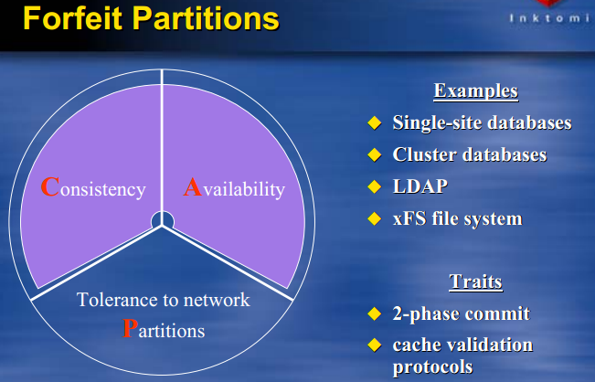
No Partitions
By Giving Up Tolerance to Network Partitions
If one node is not reachable, I am willing to make the whole system down

Slide 34
SOA
Udi Dahan’s SOA E-Van Talk Note

Slide 35
SOA
UI
BL
Back in early .NET days → no Services
Your BL / Domain objects just become a messy graph
Service is a good way to organize your business layers
UI calls services
Services will figure out which objects to create and manipulate
This is more Aggregate boundary (in DDD sense)
This is not SOA
DAL
DB
UI
Service
BL
DAL
DB

Slide 36
What is SOA then?
Service Oriented Architecture (SOA Patterns (Manning))
Service-oriented architecture (SOA) is an architectural style for building systems based on interactions of loosely coupled, coarse-grained, and autonomous components called services.
Each service exposes processes and behavior through contracts, which are composed of messages at discoverable addresses called endpoints.
A service’s behavior is governed by policies that are external to the service itself.
The contracts and messages are used by external components called service consumers.

Slide 37
SOA Conceptual Model
Policy
adheres to
governed by
End Point
binds to
exposes
Consumer
Service
serves
Contracts
understands
implements
describes
Messages
sends/receives
sends/receives

Slide 38
Microsoft’s Tenets of SOA
Four Tenets
Boundaries are explicit
Services are autonomous
Services share schema and contract, not class
Service compatibility is determined based on policy
Good in theory, but vague and hard to give directions in terms of how to start

Slide 39
SOA’s Promises
Reusability
Not ‘write-it-once, use-everywhere’
More ‘if you need the same functionality, use existing code/service’
Adaptability
Adhere to the contract, and you are OK to make change to the behaviors
Maintainability
Code can be maintained by separate smaller team

Slide 40
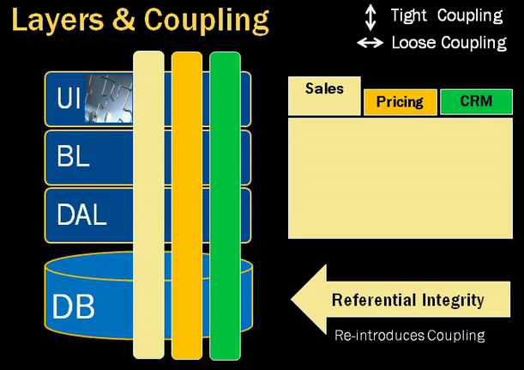
How to Find Autonomous Services
Wrong Way
Slice by Layers
Layers still have coupling Changing a field in DB will change all the way to UI
Correct Way, look at the UI segments
Align with business functions
May share data, but less coupling

Slide 41
Autonomous Service
Goal
Avoid dependencies among services
Services are loosely coupled
So
Services has its own layers (UI, BL, DAL, DB, … etc)
Services are NOT web services

Slide 42
Service Autonomy - DB
Traditionally Enterprise likes one DB
One Schema: Enterprise Data Model/Warehouse
Use Referential Integrity to enforce business rules
Strictly (and blindly) reinforce data consistency
So, DB reintroduce coupling even SOA’s goal is loose coupling
Autonomous Service
Has its own schema/tables
Do not have referential integrity across services
May loose some consistency requirements
Share the right amount of data the right way

Slide 43
Service Autonomy - UI
UI can be problematic for SOA
Services should not know each other’s data elements
UI need to present data elements
So, if UI depends on each service, or each service depend on each other to provide data, we are back to coupling

Slide 44
Service Autonomy - UI
Solution
Browser Side Composition
JavaScript Ajax to load each section asynchronously
Each section’s content is provided by each Service
The UI Layout only define the layout, each service fill in the blank
E-Bay

Slide 45
Service Autonomy - UI
Solution
Service Side Composition
Suitable when SEO is a requirement
HTTP Request is seen by all services
Each service register itself as subscriber to the HTTP Request (in ASP.NET this is implemented by HTTPModules)
Each service inject the content
At the end of the request, all contents are collected asynchronously
Amazon

Slide 46
How to Share Data Across Services
Think from Business Function’s Point of View
When do you share data?
How do you share data?
Business unit don’t assume other business unit will always respond on time
Pub-Sub is more nature for SOA

Slide 47
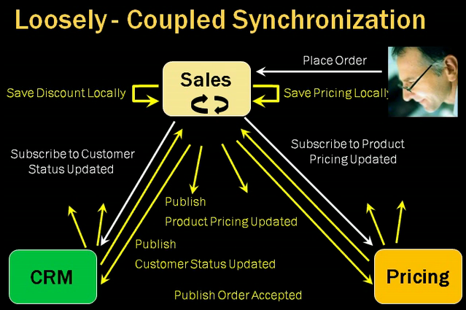
Example of Pub-Sub
When user place the order, Sales can respond quickly without depend on the response of Pricing or CRM
Pub-Sub
May have inconsistency of data

Slide 48
Eventual Consistency → Flexibility
Additional State
Ex. Temporarily Accepted
More complex, but more flexible in terms of business opportunities

Slide 49
SOA Means
No cross service communication synchronously or blocking the other services
Inside services, it is OK to have tight coupling to enforce data consistency
Use business events to communicate
Share less data (only IDs)

Slide 50
Other Issues
It is OK to deploy different services on the same node
Each services should have different UI, BL, DAL, DBs though
When to use SOA, when not to use SOA
Use SOA when multiple domains are involved
Not determined by the size of the app (team, line of code)
Small app, if involves multiple domains, still can use SOA to lay good foundation

Slide 51
Other Issues
Each service can be maintained by different teams
Each team need the full life-cycle management
Requirement/Testing/Deve/Deployment/Operation Team
Services do not have to be IT automated
Manual process can participate in SOA too
Only share IDs
In requirements if the word ‘WHEN’ is used → good indication for business events …

Slide 52
Note: Who Needs Service Bus Anyway
Service Bus
History: Hub/Spoke vs. Messaging
Underlying Messaging Pattern
Why Service Bus?
Reliability
Durable Message
Fault Tolerance
Pub/Sub
Loose Coupling

Slide 53
NServiceBus Fault Tolerance
Durable Messaging provided by MSMQ
MSMQ provides the store and send mechanism to ensure the message is delivered to the target queue
If the target machine is down, the message will stay there until the target machine come back online and process the message

Slide 54
NServiceBus Fault Tolerance
DTC Transaction
If the message queue is part of transaction DTC, if the processing App throws an exception:
The message will go back to the receiving queue and the retry mechanism will start

Slide 55
NServiceBus Fault Tolerance
Retry mechanism
Immediate Retry
Retry N Times (based on config)
Second Level Retry
Retry after certain intervals (based on config)
Error Queue & Send-Back-To-Sender
Centralized Error Queue → Easier for Admin
If the message cannot be de-serialized, it will by-pass all retry and goes directly to error queue

Slide 56
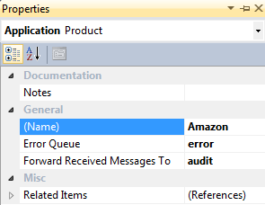
NServiceBus Audit
You can set ForwardReceivedMessagesTo on the end point to allow auditing to a centralized location or an auditing app

Slide 57
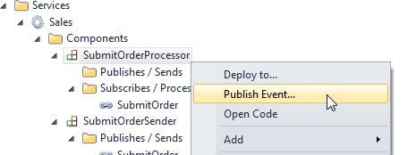
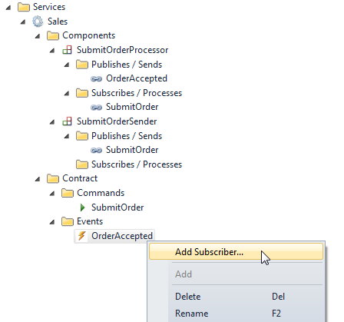
NServiceBus Pub/Sub
Click on the component that publish the event
Select "Publish Event...”
Set Name “OrderAccepted”
Create Subscriber
Add subscriber ‘Billing’
This will create a new Service

Slide 58
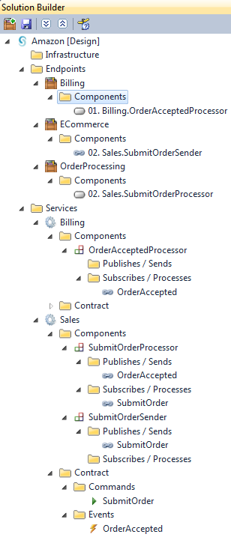
NServiceBus Pub/Sub
Add a new endpoint ‘BillingProcessingApp’
Deploy the component to the new endpoint
To publish the event: Bus.Publish<OrderAccepted>();

Slide 59
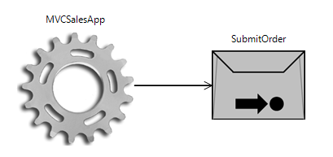
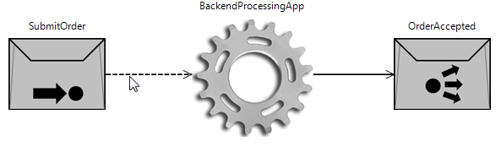
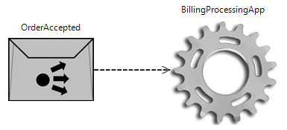
NServiceBus Pub/Sub Diagrams
MVCSalesApp
BackendProcessingApp
BillingProcessingApp

Slide 60
NSeviceBus vs. RPC
RPC: Remote Procedural Call
Abstract out the ‘remote-ness’
Call remote process just if it is a local method (same stack)
Problem: coupling
Design time
Runtime

Slide 61
Calling WCF/Web Service
Calling web/wcf services
As part of message handling logic where that logic is also updating transactional resources like a database, the best practice is to split that up into two endpoints.
In the case where you don't require a response from the web/wcf service, have the first endpoint publish an event that the second endpoint is subscribed to (more faq info) and have the second endpoint call the web/wcf service.
In the case where you do need a response from the web/wcf service, turn the first endpoint into a saga that sends (not publishes) a message to the second endpoint, which calls the web/wcf service and replies with a response, that is handled by the saga in the first endpoint.

Slide 62
Note: Availability by Udi Dahan
http://vimeo.com/6222577#at=0

